Slide 1

Smart City
Urban Well-being Analysis and Intervention System
Group 64:
Yulun Feng
Yuelu Zhang

Slide 2
Project Overview & Objective
Notes:
Yuelu Zhang

Slide 3
System Features
Real-time data collection
Wellness Scoring System
Root Cause Identiication
Notes:
Yuelu Zhang

Slide 4
System Architrecure
Notes:
Yulun Feng

Slide 5
UI/UX Wireframes
Notes:
Yuelu Zhang

Slide 6
UI/UX Wireframes (cont.)
Notes:
Yuelu Zhang

Slide 7
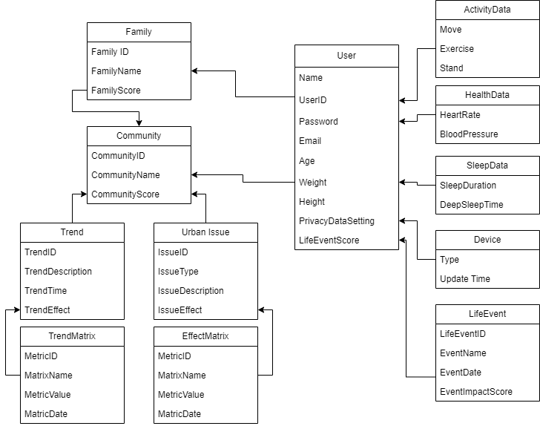
Domain Model
High Price
Technological Integration
Notes:
Yulun Feng

Slide 8
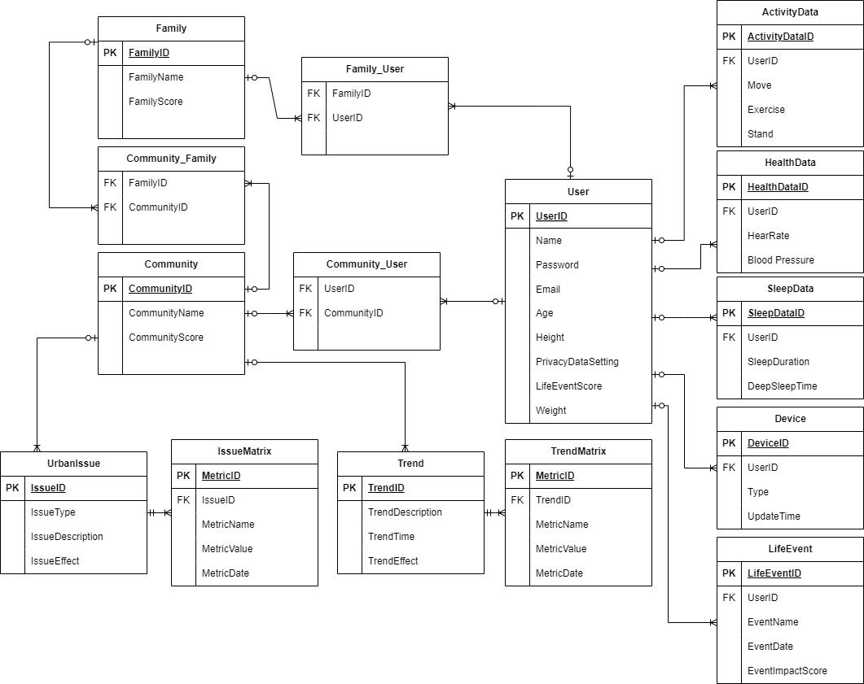
System Database Schema (Encrypted SQL)
Notes:
Yulun Feng

Slide 9
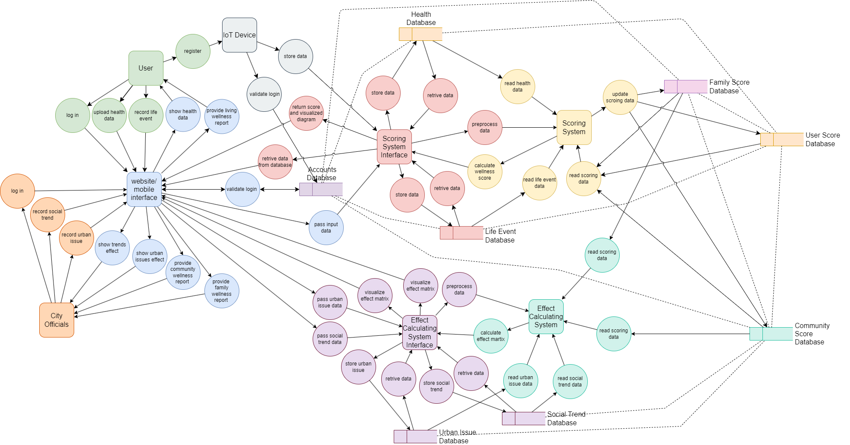
System Data Flow
Notes:
Yulun Feng

Slide 10
Data Analysis Strategy
Collect & Preprocess
Weight Calculation
Machine Learning
Family and Community Level Adjustment
Phase 2
Load Data from database
Data Cleaning
Data Normalization
Encode Categorical Data
Package used:
pandas
numpy
scipy.stats
sklearn.preprocessing
Define Key Metrics
Assign Weight
Calculate Individual Score
Aggregate Wellness Score
Package used:
pandas
numpy
Load pre-trained model
Fine-tune the model
Predict adjustment
Combine Predictions with Weighted Score
Packages used:
transformers
tokenizer
datasets
Retrieve data
Apply family-level adjustment
Calculate family wellness score
Calculate community score
Adjust for social trends
Packages used:
numpy
pandas
sklearn.preprocessing
Notes:
Yulun Feng

Slide 11
Challenge Scenarios & Solution Demonstration
1. Constructing a new hospital
2. Implementing a comprehensive health education program
Notes:
Yulun Feng

Slide 12
Challenge Scenarios & Solution Demonstration (cont.)
3. Investing in youth intervention programs
4. Expanding economic opportunity initiatives
Notes:
Yulun Feng

Slide 13
Privacy Policy and Ethic Considerations
Privacy and Security
User Consent
Ethical Data Use
Technological Integration
Legal and Regulatory
Data Encryption
Access Control
Data Anonymization & Pseudonymization
Data Access Logs and Audits
Informed Consent
Data Sharing Preferences
Data Retention Policy
Right to Deletion
Purpose Limitation
Non-Discrimination
Transparency in AI Algorithms
Regulatory Compliance
Privacy by Design and Default
Ethics Board Review
End-User Accountability and Support
Notes:
Yuelu Zhang

Slide 14
Real-World Impact and Scalability
Technological Integration
Notes:
Yuelu Zhang

Slide 15
Thank you!

